Slide 1
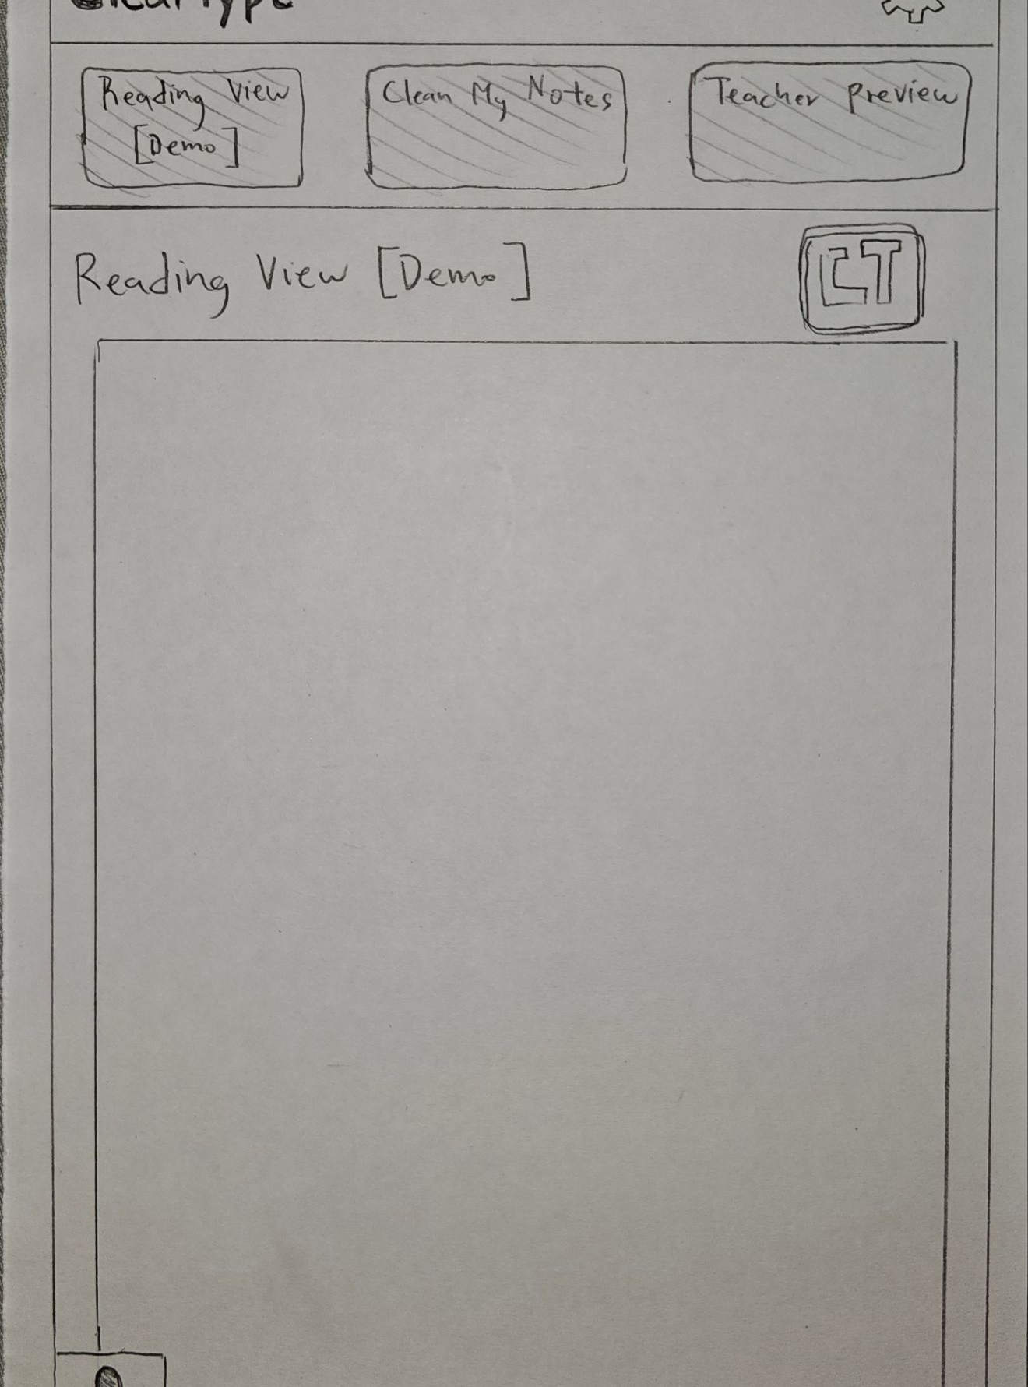
SPP5: Low-Fi Prototyping & Pilot Usability Testing
Alfred Acosta, Javier Coyoc, Ervin Lin

Slide 2
Mission/Value:
“Making web content readable for every mind”
Standard digital learning materials and web pages use dense layouts, harsh contrast, and rigid typography that cause rapid visual fatigue for dyslexic readers. ClearType is an interactive web platform that lets students and teachers preview, test, and toggle dyslexia-friendly formatting in real time through instant visual overlays and live controls.

Slide 3
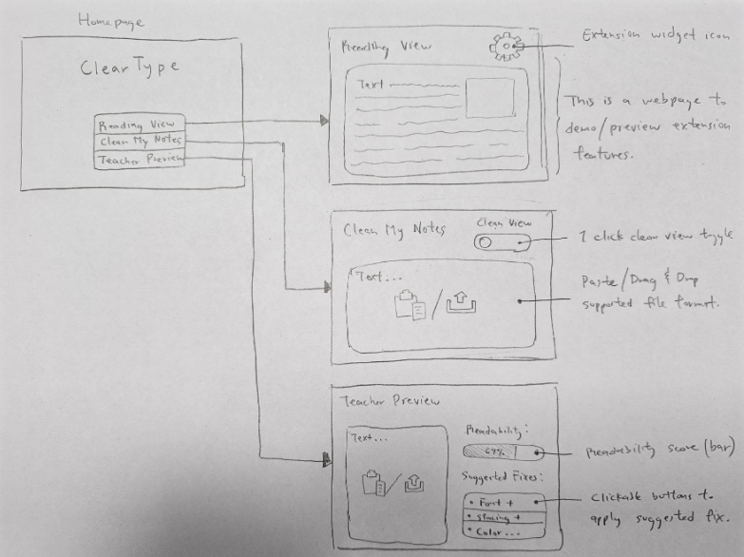
selected interface & rationale
Web App/ Extension
We selected the Web App/Extension Interface
Offered better accessibility for user
Navigation is more familiar & easier compared to other interfaces such as speech where you would have to remember the speech commands

Slide 4
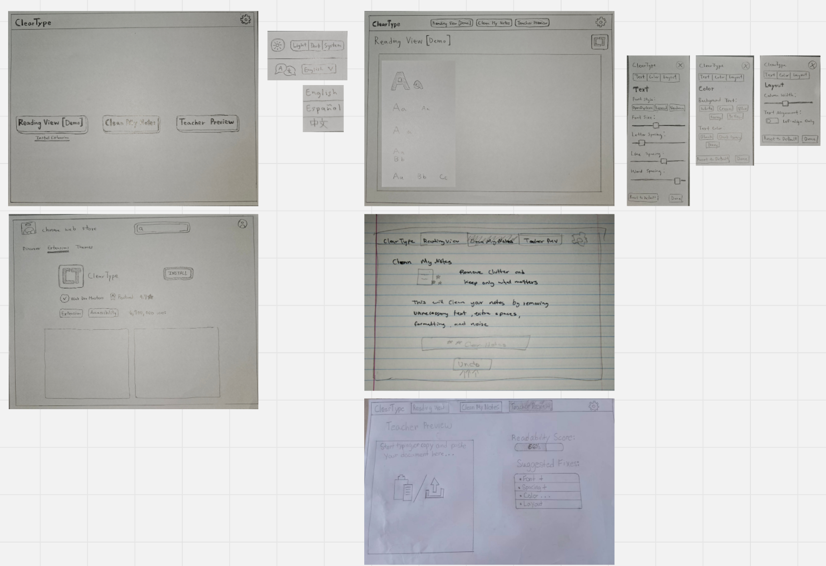
Low-fi prototype structure

Slide 5
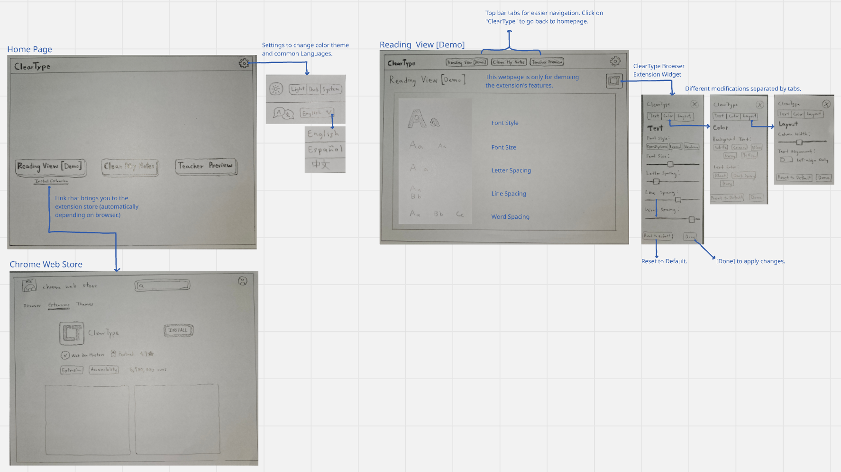
Task 1: Use Reading View [Demo]
A user will:
Change color mode/language
Install ClearType Browser extension (automatically brings the user to the right store).
Enter Reading view [Demo]
Change:
  Font style
  Font size
  Letter spacing
  Line spacing
  Word spacing
Other extension features can be accessed via navigation tabs.

Slide 6
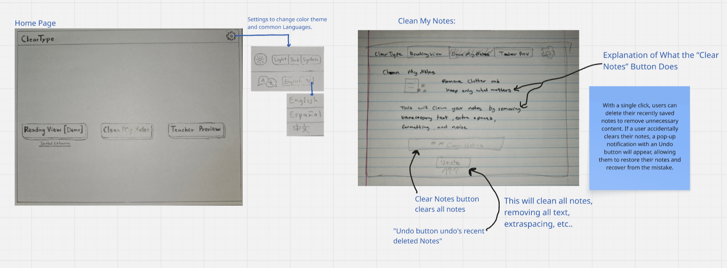
Task 2: Use Clean My Notes
A user will:
Want to delete recent notes
By clicking on “Clear NOtes”
It instantly deletes the notes
All font spaces, styles, size, etc…
If the user accidentally deletes a recently saved note, an Undo button will appear, allowing the student to restore the deleted note.

Slide 7
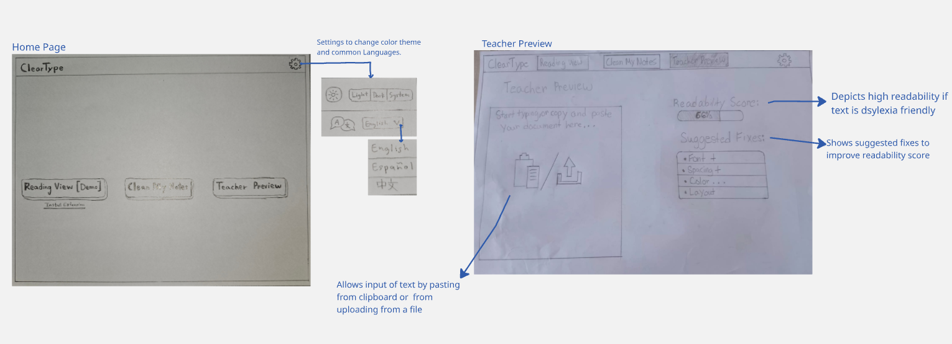
Task 3: Use teacher preview
User will be able to:
Change the color theme & language
Enter Teacher Preview
Will enter text using either one of the input methods
Check their readability score when the text is entered
See & Apply suggested fixes (Font, Spacing & Color)

Slide 8



Participants
Mr. Acosta
Ms. Coyoc
Student A
Principal / Teacher
Former Teacher
Student

Slide 9
How The Experiment Data Was Captured
Participant ID | Task Name | Task Difficulty | Errors / Misclicks | Completion Time (sec) | Critical Incident Description (Process Data) | Severity Rating
P1 | Task 1: Reading View Customization | Simple
P1 | Task 2: Clean My Notes | Moderate
P1 | Task 3: Teacher Preview | Complex

Slide 10
Experimental Results
Participant 1 (Mr. Acosta): Mr. Acosta went through the simple tasks quickly. When he reached the Teacher Preview task, he easily found the "Suggested Fixes" and was able to apply formatting edits to boost the readability score.
Participant 2 (Ms. Coyoc): Ms. Coyoc saw the raw text on the homepage, but didn't realize it was a link and assumed she had to manually search for the extension in the Chrome Web Store. Once past that problem, she was back on track. She also appreciated having the "Undo" safety button when she accidentally double-clicked to clean her notes.
Participant 3 (Student A): Student A breezed through the note-cleaning and teacher preview tasks with ease, but found the extension widget a bit confusing when trying to toggle their reading view. They noted that having every single slider (font size, letter spacing, line spacing, and word spacing) stacked vertically made it overwhelming to locate specific settings quickly.

Slide 11
Suggested UI Changes
Participant 1 (Mr. Acosta): Add a live score-impact preview next to the clickable "Suggested Fixes," as he suggested wanting to see how many points a fix would raise his readability score before clicking to apply it.
Participant 2 (Ms. Coyoc): Improve the extension installation process by adding a direct "1-Click Install" pop-up or a step-by-step installation guide right on the homepage, this is to make it more obvious the extension page can be accessed in 1 click rather than manually looking for it.
Participant 3 (Student A): Improve the extension widget by grouping settings into collapsible categories or adding presets (e.g., "Compact" vs. "Spacious"). This is to prevent slider overload and help users adjust their reading view much faster.

Slide 12
Thank you!

